Slide 1


The First Challenge: The Participation Barrier
For many people, crypto is still something they associate with investment or speculation.
And honestly, creating a wallet is still too complicated.
Because of that, most people never get the chance to actually experience the practical value of Web3 in their everyday lives.

Slide 2
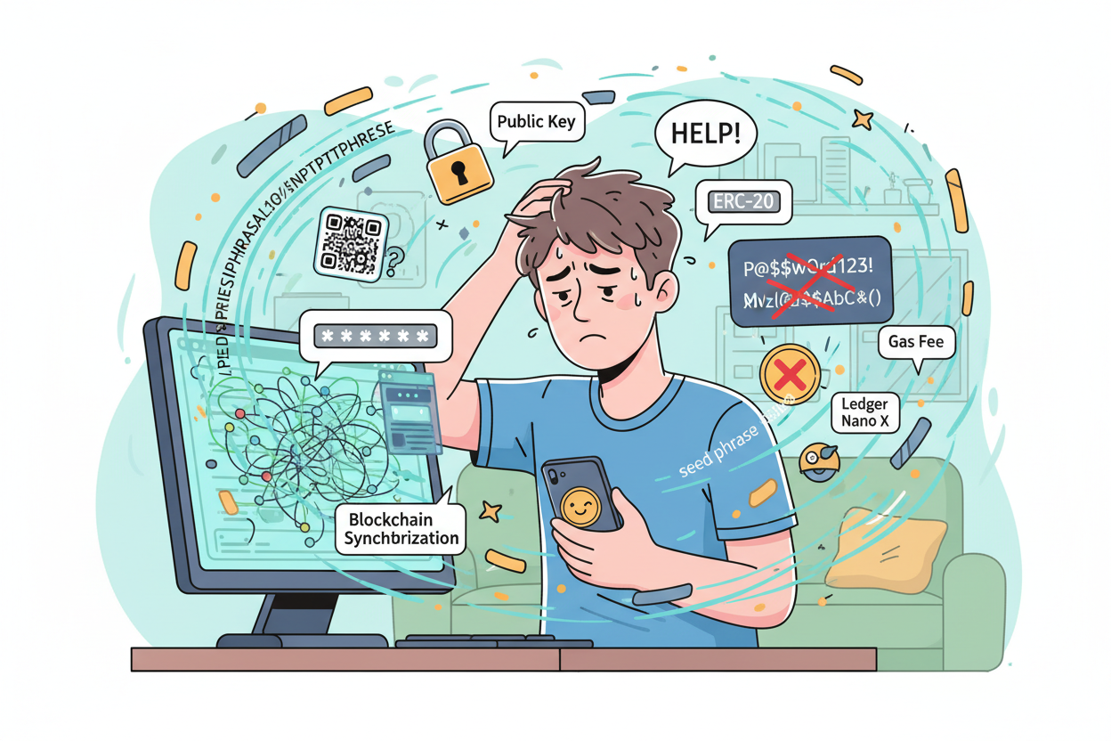
2. The Second Challenge: The Fragmentation Barrier
Even people already inside Web3 struggle with this.
Managing different wallets for different chains—Ethereum, Solana, Base—it’s overwhelming.
Assets are scattered everywhere, and the overall experience is still far from simple.

Slide 3
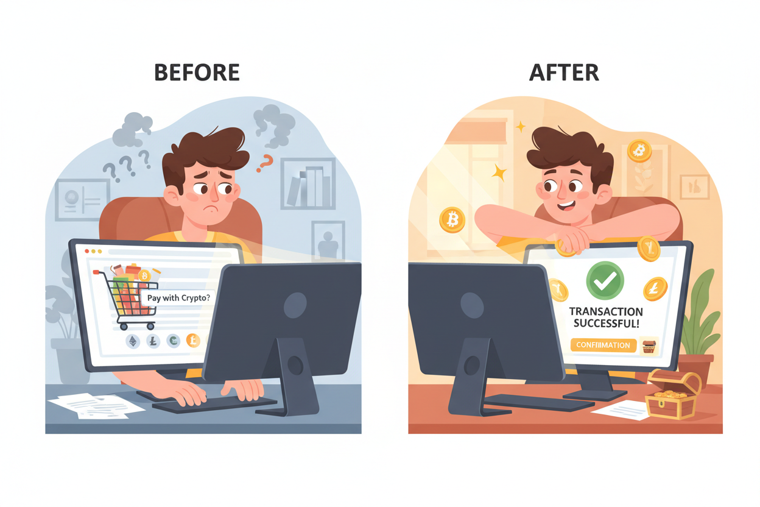
Our Solution: Crypify
Crypify breaks down these two difficult barriers with a single, seamless flow that starts from
something everyone already understands: making a purchase on an e-commerce site.
Let me walk you through it.

Slide 4
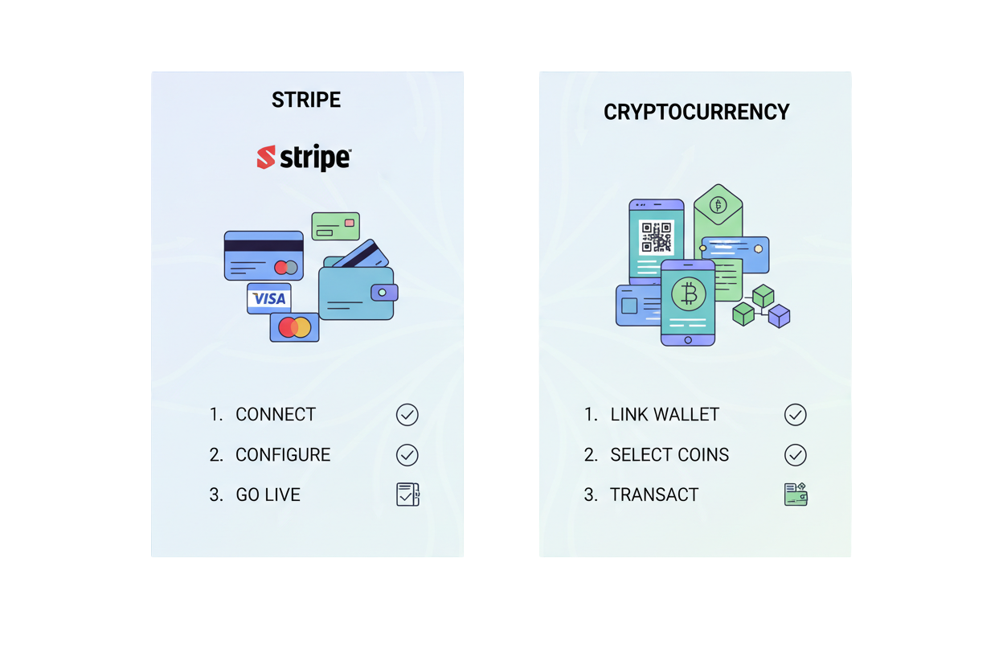
Easy to Implement — Like Stripe
And the best part?
Integrating Crypify into an e-commerce site is extremely simple.
Just like Stripe, it works with only a few lines of code.

Slide 5
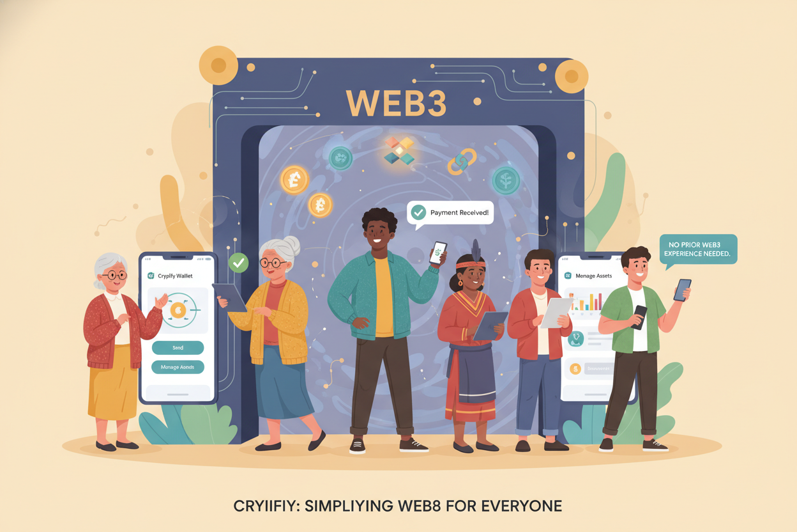
Crypify allows anyone—even people who have never touched Web3—to enter the ecosystem
by simply receiving crypto and managing it easily.

